Slide 1
Cancer Biology Biol 445
Spring 2020
Dr. Heidi Super
Lecture 24
4-1-2020

Slide 2
Checking in….
Check your email for upcoming events related to the class.
Questions about your personal workload
Blackboard collaborate ultra meeting—2 scheduled times.
Quiz 4 coming Monday
Long term plans for the class

Slide 3
Where were we? Carcinogens
What is a dose-response curve? ED₅₀? (LD₅₀, LC₅₀)?
Correlations vs. Causation
Bias—define. Do recent reports of COVID-19 incidence reflect detection bias at a certain level? Might the general public sometimes misunderstand what’s going on due to detection bias?
Give an example of how a study of COVID-19 might contain selection or publication bias

Slide 4
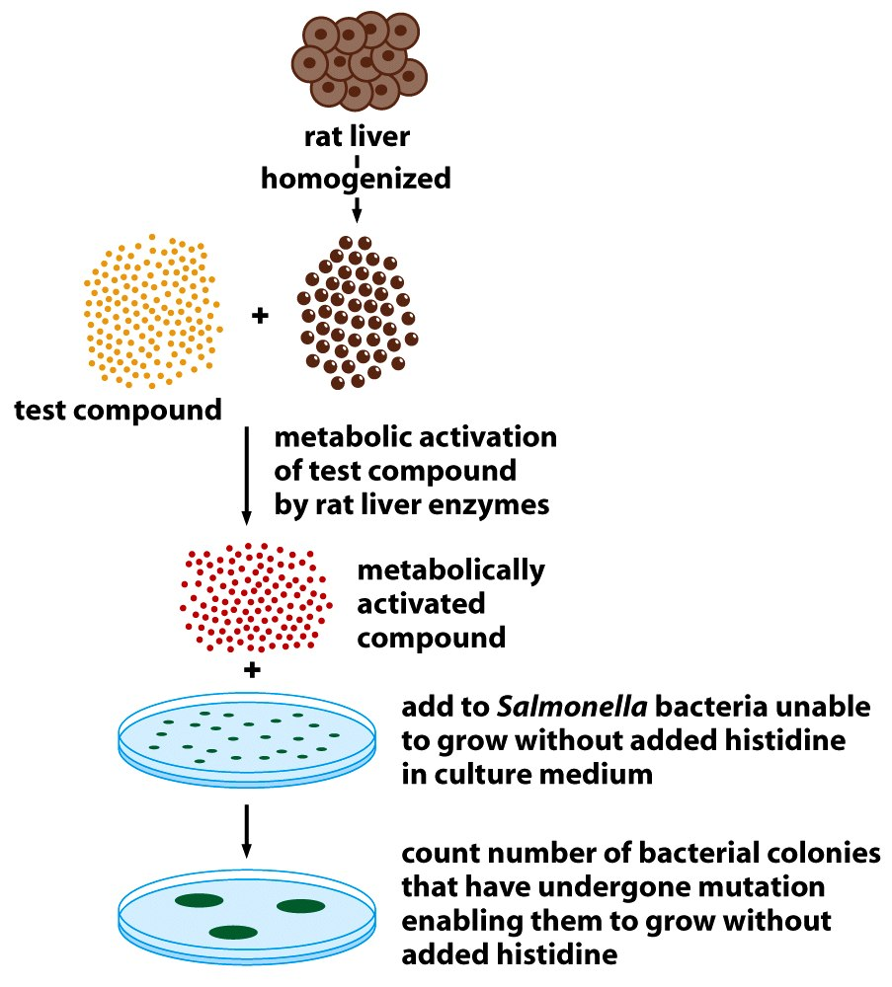
Explain how the Ames test works to identify potential carcinogens
Figure 2.24 The Biology of Cancer (© Garland Science 2007)

Slide 5
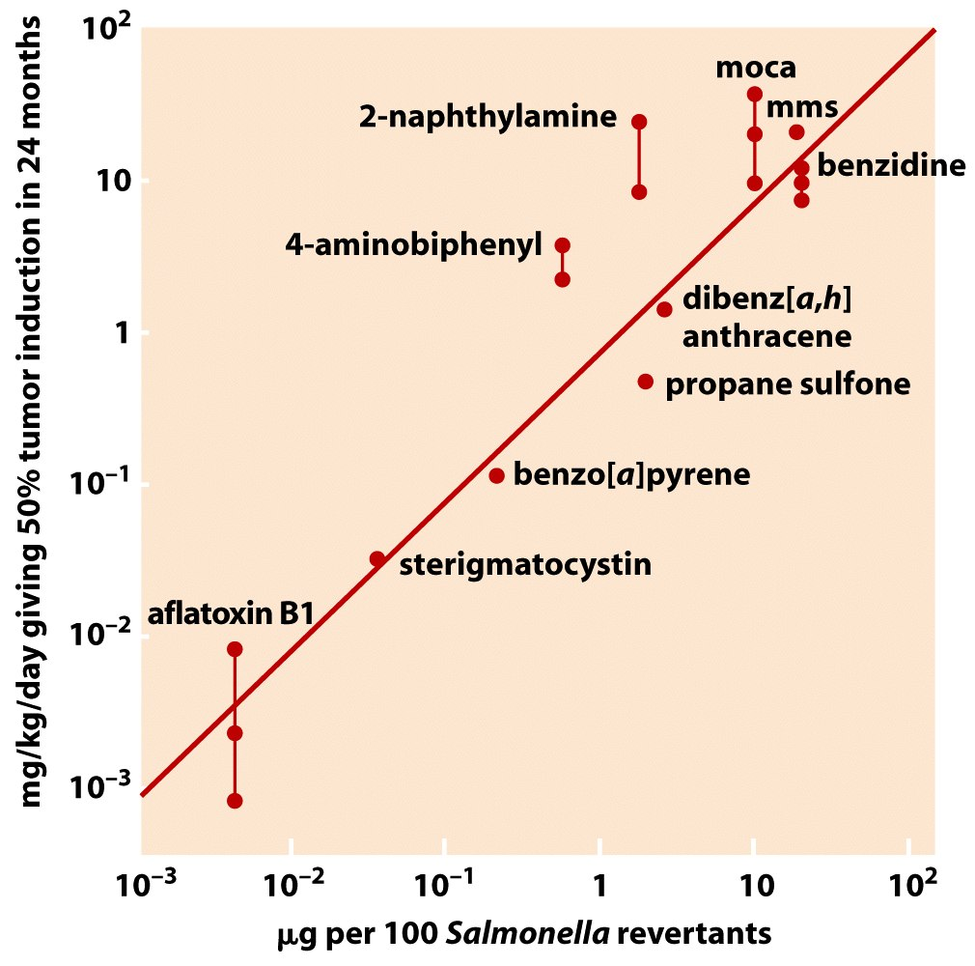
What is the take home message of the slide?

Slide 6
Ames tests/Animal testing fail to identify a class of cancer-associated agents…
Tumor promoters
Agents that act on cells AFTER accumulated mutations have initiated abnormal growth.
Most lead, indirectly, to mutations by simply increasing the rate at which the clone of cells divide.

Slide 7
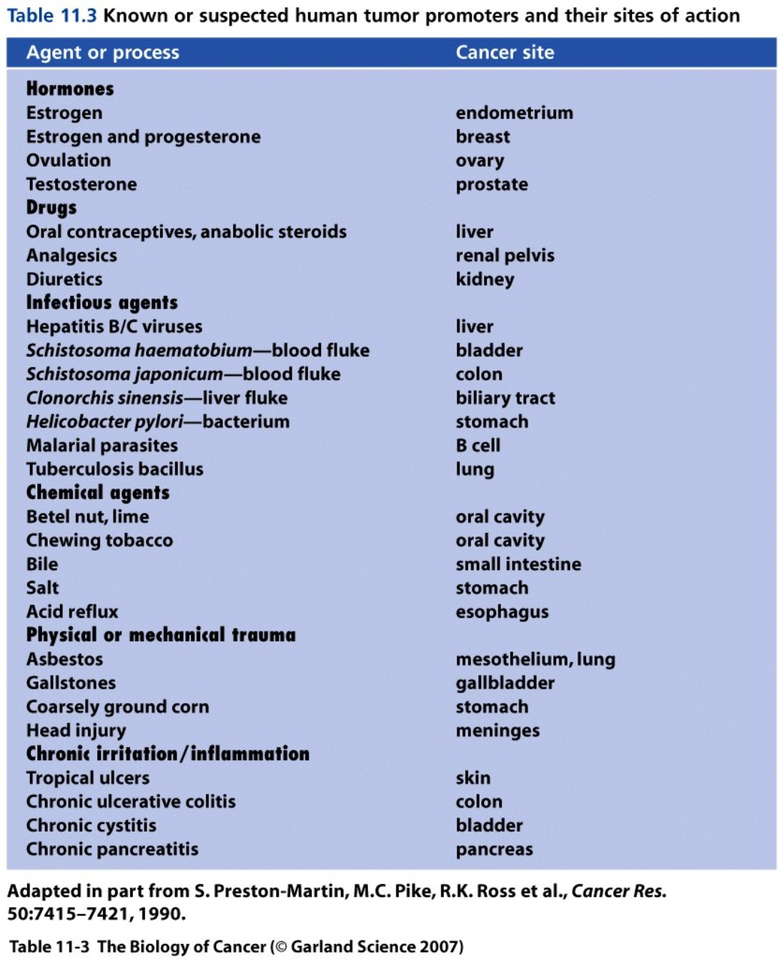
Tumor promoters

Slide 8
What if one thing has many chemicals?
Like Robert Koch’s approach to sorting out which germ is causing a particular disease, mixtures of chemicals must be tested individually for mutagenicity and then carcinogenicity.
But…holy SMOKES (pun intended), look at how MANY carcinogens are found in one source---Tobacco smoke! Figure 4-2

Slide 9
Despite the challenge in linking cause to disease, smoking is unquestionably the largest risk-factor for many types of cancer.
Cause-effect criteria?
Cause precedes the disease.
Overlap or parallel trends
Dose-response effect
Statistical significance and > 2-fold increase
Elimination of bias

Slide 10
https://www.cancer.org/cancer/cancer-causes/tobacco-and-cancer/carcinogens-found-in-tobacco-products.html
Figures 4-7, 4-8, 4-9

Slide 11
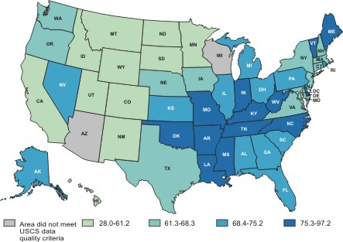
Lung cancer Incidence
Age adjusted rate/100,000 people

Slide 12
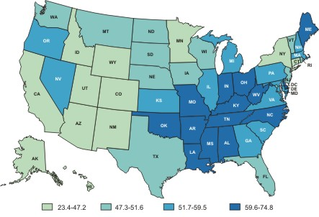
Lung cancer Deaths
Age adjusted rate/100,000 people

Slide 13
A sobering, effective attack ad for smoking
2007? Why was it effective?
Why is important to show that young people can be affected?
http://www.youtube.com/watch?v=zuh2w2sFRMI

Slide 14
Recent discovery of new type of lung cancer

Slide 15
Never-smoker lung cancer
Accounts for as much as 15% of lung cancer cases
Molecular studies show a unique subset of DNA mutations associated with the NS lung cancer
MORE mutations than smoker-related lung cancer. (possibly more genetic instability)
Mutations in epidermal growth factor receptor (EGFR)
SOURCE: The Ninth Annual AACR Frontiers in Cancer Prevention Research Conference, 7 – 10 November 2010

Slide 16
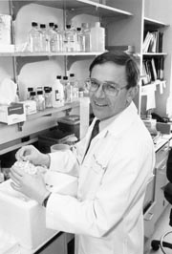
Stanley Korsemeyer—Contributed tremendously to understanding of cancer---specifically, lymphoma.
Died of NS Lung cancer age 55

Slide 17
What about alcohol?
Mostly considered a tumor promoter—where ingestion allows contact with epithelium.
Increased cancer-risk for mouth, throat and stomach cancers
Leads to chronic inflammation—cirrhosis in liver—increased incidence of liver cancer

Slide 18
Alcohol seems to act synergistically with tobacco in inducing cancers of the throat and mouth.
http://archotol.ama-assn.org/cgi/reprint/130/3/303
(Paper to read—see PDF linked to website)
4-10 YIKES!

Slide 19
Food-containing carcinogens
Synthetics---man-made or utilized
--Pesticides, preservatives, additives
Naturally-occurring chemicals
Pest resistance chemicals produced by plants
Table 4-3—Keep in mind the point made earlier, that data must be carefully analyzed. What dose does the average human consume of these foods? Is it comparable to that tested in animals?

Slide 20
Figure 2.25 The Biology of Cancer (© Garland Science 2007)

Slide 21
Aflatoxin is produced by Aspergillus, a mold which is common on grain and nuts.
Highly mutagenic/carcinogenic
It’s inhibition by synthetic by synthetic pesticides in developed countries likely outweighs the risk of ingesting the pesticide!

Slide 22
Preservatives
Salt, nitrites, nitrates used to preserve meat and fish.
Hotdogs, bacon, etc.
Linked to stomach cancer---
Salt—prolonged exposure leads to inflammation
Nitrates/nitrites---metabolic intermediates made in stomach are highly carcinogenic

Slide 23
From WHO report http://ichef-1.bbci.co.uk/news/624/cpsprodpb/1197F/production/_86336027_cancerous_meat_624.png

Slide 24
Red meat, fat
High red meat consumption correlates with high colon cancer rates.
Figure 4-11

Slide 25
Why?...
Difficult to pinpoint the mechanism.
More red meat=less fruit/veggies (with potential anticancer chemicals)
More red meat =more saturated fat
More red meat =more calories=more obesity
More red meat = more carcinogens produced by cooking methods (grilling, or high prolonged heat)

Slide 26
Likely that all the correlated exposures related to consuming red meat indirectly lead to increased DNA damage to colon cells.
Clearly the components of consumed red meat make their way through the colon!
Evidence that the longer it takes for food to make its way through, the longer those chemicals are in contact with cells of the colon.

Slide 27
Anticancer? food /chemicals…
Lycopene---tomatoes
Epigallocatechin gallate---green tea
Resveratrol—red grapes (wine! ☺)
Sulfides-wine, garlic
See website linked to USDA/ NCI information!
**Any info from students in Dr. Shipunov’s ethnobotany class?

Slide 28
Antioxidants
Compounds that inhibit oxidation reactions.
Oxidation reactions create free radicals that can damage/change DNA.
Avoiding mutations, reduces cancer risk.

Slide 29
USDA rankings for antioxidant activity
Small red bean (dried)
Wild Blueberry
Red kidney bean
Pinto bean
Cultivated blueberry
Cranberry
Artichoke
Blackberry
Prune
raspberry

Slide 30
Be smart!
Don’t accept merely anecdotal support for a carcinogen or anti-carcinogen claim.
Look for published experimental evidence.
In published evidence, look for proper controls, be aware of bias—make sure the publication does not come from a company that makes money from the product.
Make sure the publication was reviewed by experts (peer review process).

Slide 31
Revisiting mutagens we’ve studied (as carcinogens)
2 primary classes:
UV
Ionizing

Slide 32
Correlation
UV—sunlight exposure linked to skin cancer
Much higher incidence in people of light skin (melanin absorbs UV radiation and keeps it from inducing DNA damage)
Much higher incidence in locations of intense, prolonged sun or individuals who intentionally expose themselves to UV (outside, tanning beds)

Slide 34
Causation
Recall---what does UV radiation do to DNA?
What’s the direct link to cancer?
We will discuss various types of UV radiation in a future lecture.

Slide 35
Chapter 6—radiation and cancer
Radiation
Any type of energy that can travel.
Heat, sound, cosmic radiation, radio waves, microwaves, visible light, UV light, X-rays, energy emitted from nuclei of atoms.
You are exposed to different forms of essential radiation all the time.
Typically the higher the energy, the more potential for DNA damage and cancer risk.

Slide 36
Energy content is inversely proportional to wavelength
Figure 6-3 and below…

Slide 37
Sunlight—UV engergy
Sunlight composed of 3 classes/wavelengths of UV energy
UVA, UVB, UVC—in decreasing order of wavelenth.
Most UV reaching the earth is UVA—no filter in earth’s atmosphere.
Lowest energy---requires long-term exposure to cause cancer (tumor promoter)

Slide 38
UVB
Primary wavelength to cause cancer (mostly skin cancer). Figures 6-1, 6-2
Most UVB absorbed by ozone layer of earth’s atmosphere.
UVB that reaches earth surface is responsible for skin tan, burn, aging (dryness/wrinkling), sking cancer

Slide 39
UVC---most dangerous, but does not reach earth at all.
Can be made in artificial light sources. Used to sterilize meat/food and surfaces of medical and research equipment. Tissue culture hood!
Short exposure can burn terribly

Slide 40
UVB
Induces that DNA lesion called Pyrimidine dimer.
Figure 6-4
How is the disease Xeroderma Pigmentosum (XP) connected?

Slide 41
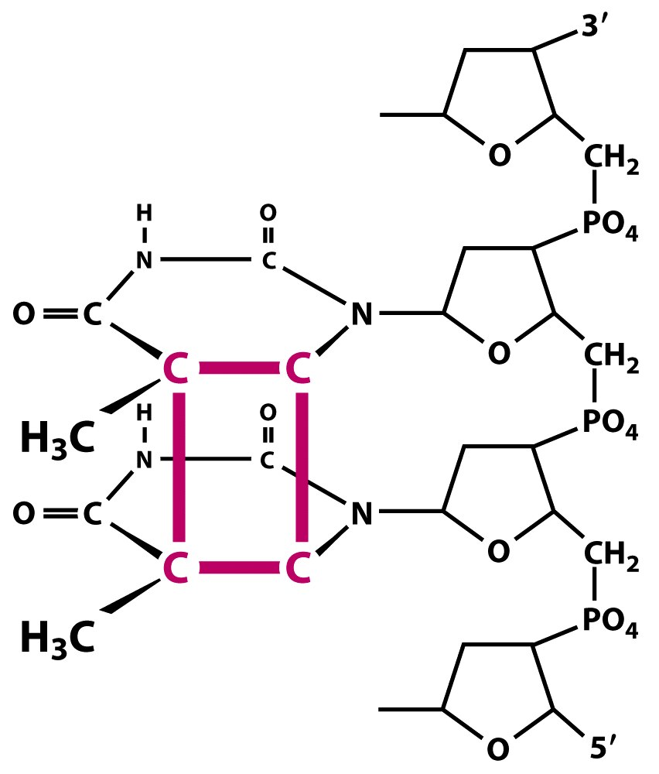
Figure 12.14a The Biology of Cancer (© Garland Science 2007)

Slide 42
Note—two C nucleotides side by side in one strand of DNA---di-pyrimidine sequence. C-C or C-T or T-T.
G
G
Not base pairing!
Figure 12.14a The Biology of Cancer (© Garland Science 2007)

Slide 43
Which gene(s) are important in skin cancer?
Non-melanoma---(basal cell or squamous cell carcinoma) routinely shows a “UV signature” with pyrimidine dimer-induced mutations in p53 gene!
Mutations in p53 are non-random changes—affect the coding sequence—change the protein. Figure 6-5 and 6-6

Slide 44
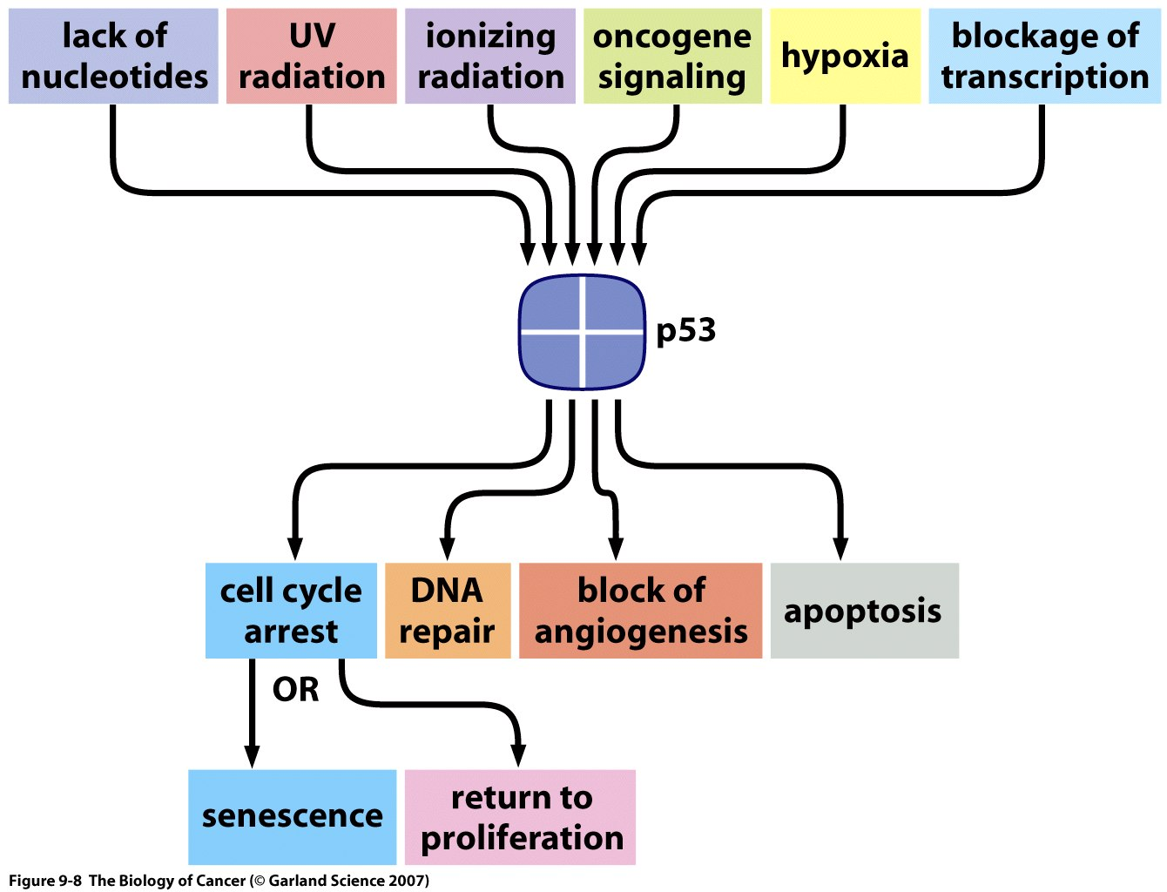
Recall?

